Slide 1

Gene Regulatory Networks
“A milestone on
understanding
How our inside work.”

Slide 2
Team Members
Abdelrahman Hisham Mostafa
Merna Atef Salah
Peter Emad Salah

Slide 3
Sections
Introduction to Gene Regulatory Networks (GRNs)
Available Methods
Data
Constraint Satisfaction Problem (CSP) formulation.
Implementation

Slide 4
Introduction

Slide 5
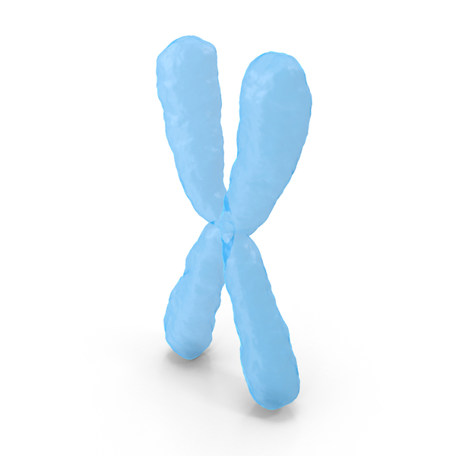

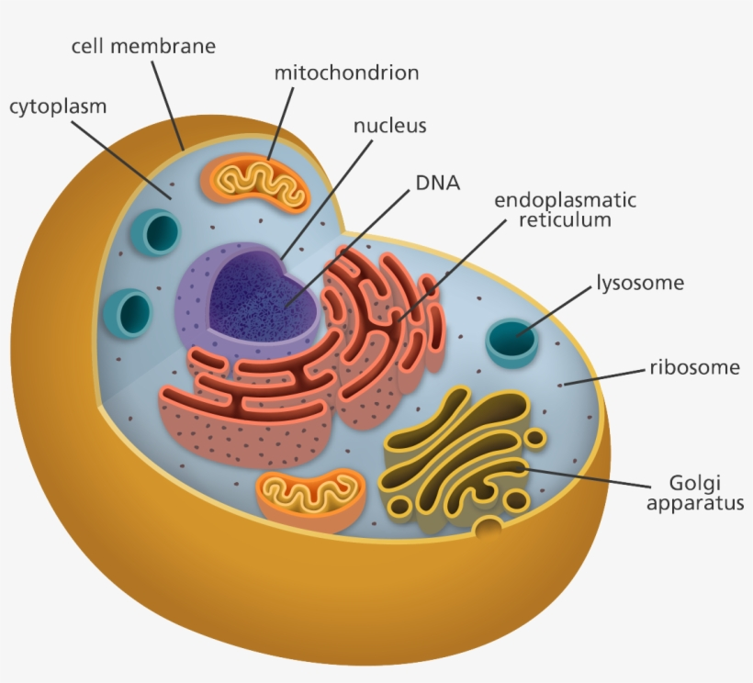

Genes

Slide 6
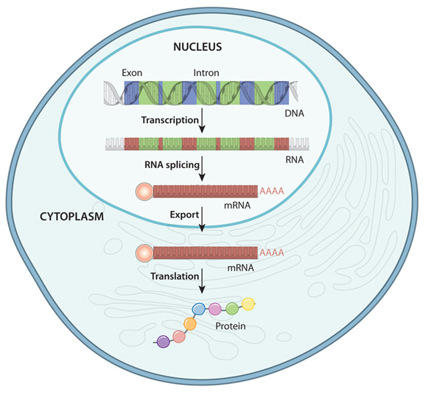
Expression Levels
Information
Functional
Product

Slide 7
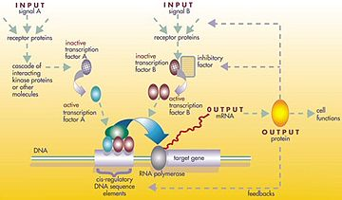
Gene Regulatory Networks
Regulators:
DNA
RNA
Proteins

Slide 8
Methods

Slide 9

Available Methods for GRNs
MINET
GENIE3
TIGRESS
GRADIS

Slide 10
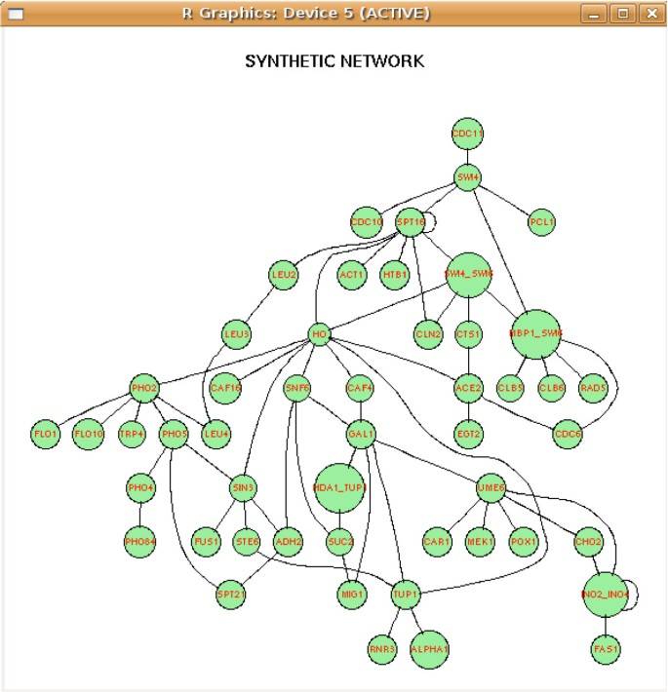
MINET (Mutual Information)
Network is built in 2 steps:
Mutual information between all pairs of variables.
Algorithm given by certain method considers the estimated mutual information in order to build the network

Slide 11
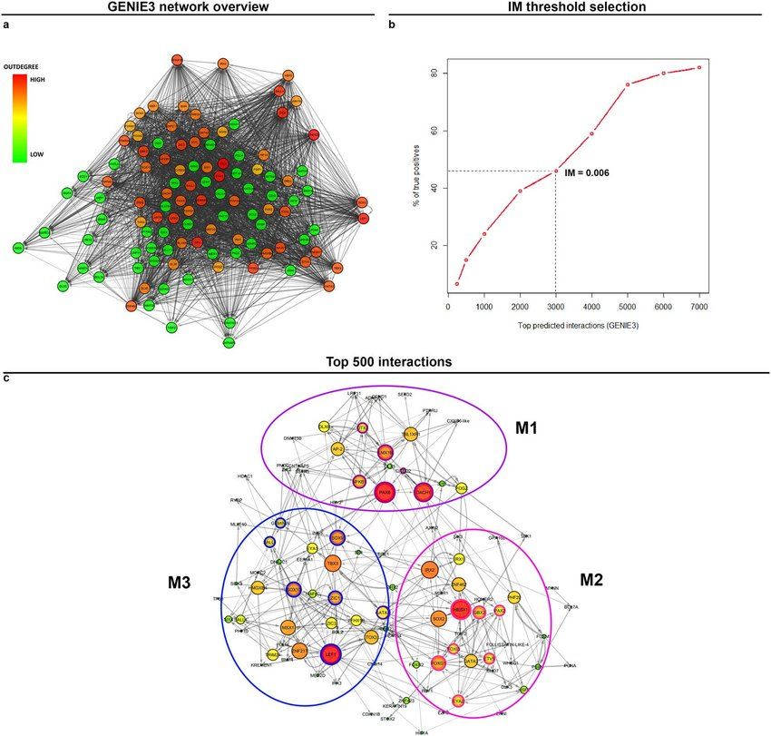
GENIE3
Tree Based.
Network from Multifractional Expression Data.
Inferring a network of size p into p different feature selection problems

Slide 12
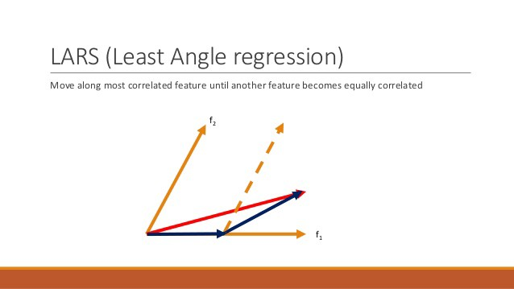
TIGRESS
P independent regression problems taking each target gene.
LARS feature selection.

Slide 13
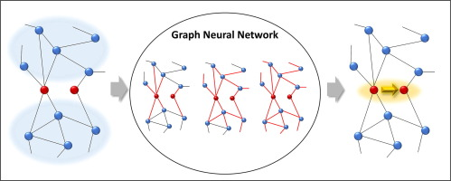
GRADISS
Graph Representation of the whole network.
GRN inference is graph classification problem.

Slide 14
DATA

Slide 15
DREAM4
In silico network challenge, a benchmark suite for performance evaluation of methods for gene network inference (reverse engineering).
Training/Test datasets (in-silico, in-vivo)
Data:
https://www.synapse.org/#!Synapse:syn2787211
https://www.synapse.org/#!Synapse:syn3049712/wiki/74628

Slide 16
In-Silico10
Simulated gene network of 10 genes
Experiments
Gene Knockdowns → Gene is suppressed
Gene Knockouts → Permanent deactivation of a gene through genetic engineering.
Multifactorial → Simulated by increasing or decreasing activation of all genes simultaneously by different random amounts.

Slide 17
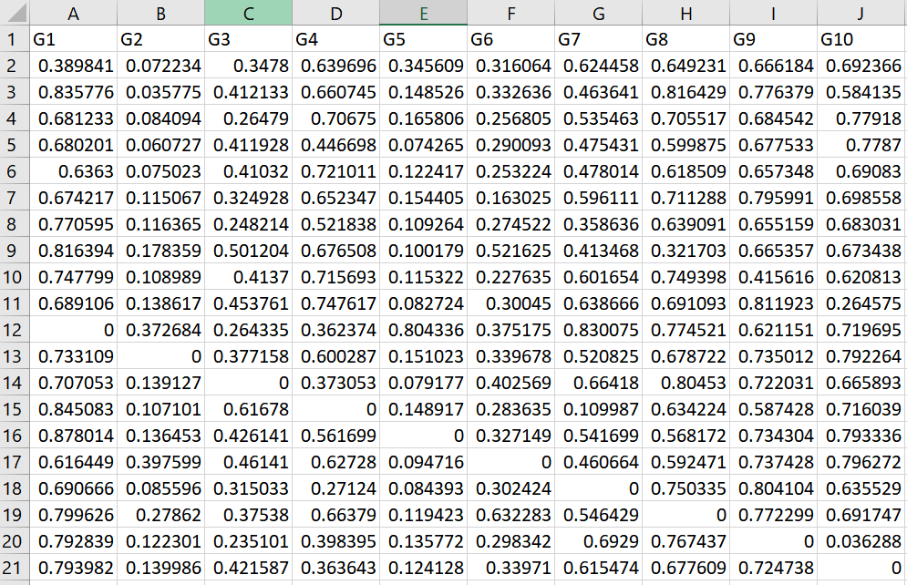
In-Silico10 Data

Slide 18
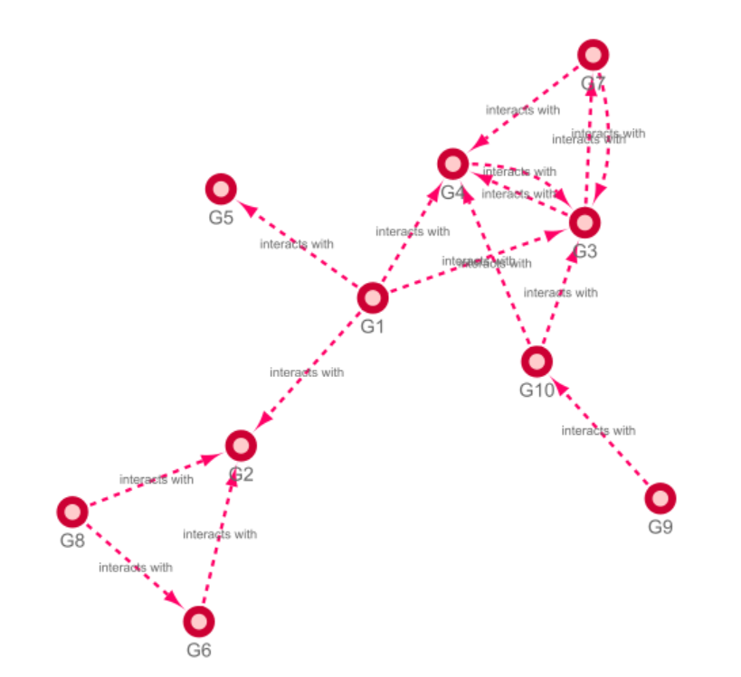
In-Silico10 Gold Standard

Slide 19
USED Methods

Slide 20
GRN Inference

Slide 21
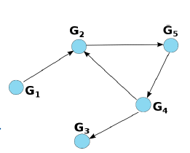
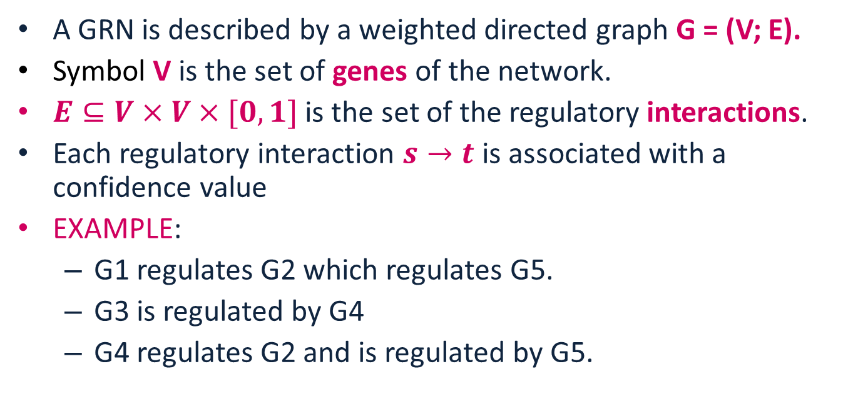
Modelling
A GRN is described by a weighted directed graph G = (V; E).
Symbol V is the set of genes of the network.
$E⊆V×V×[0,1]$ is the set of the regulatory interactions.
Each regulatory interaction $s→t$is associated with a confidence value
EXAMPLE:
G1 regulates G2 which regulates G5.
G3 is regulated by G4
G4 regulates G2 and is regulated by G5.

Slide 22
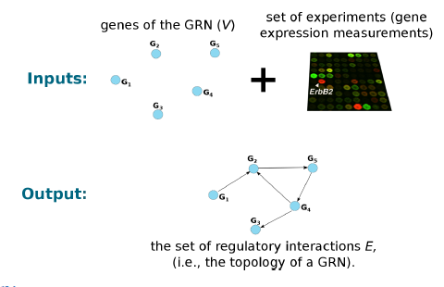
Inference
Notes:
we are given the set of vertices V and a set of experiment describing the behavior of the regulatory elements.

Slide 23
Methods
Each method:
Based on different assumptions.
Exhibits peculiar limitations.
Use multiple inference models, community prediction.

Slide 24
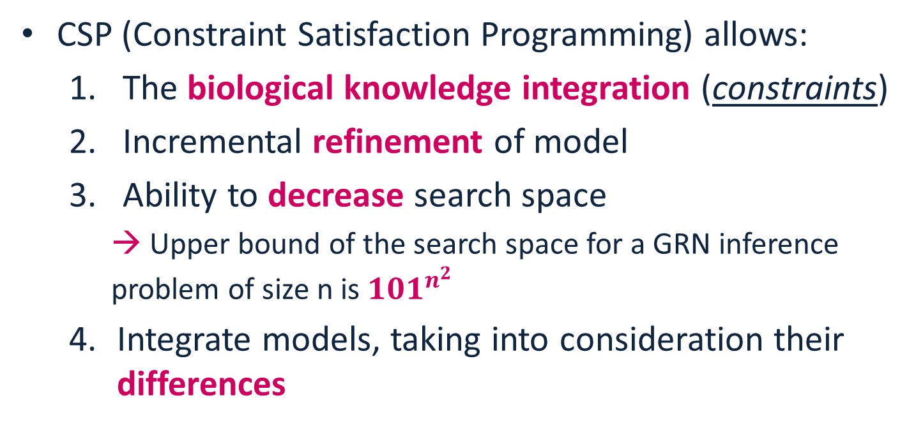
Why CSP?
CSP (Constraint Satisfaction Programming) allows:
The biological knowledge integration (constraints)
Incremental refinement of model
Ability to decrease search space
→ Upper bound of the search space for a GRN inference problem of size n is ${101}^{n^{2}}$
Integrate models, taking into consideration their differences

Slide 25
Ensemble Inference
Generate GRNs using 3-top performing algorithms by feeding them the dataset.
Use CSP to integrate community predictions.
Compare with other Ensemble Methods or Gold Standard.

Slide 26
Top Algorithms
GENIE3 (2010)
Tree-based
Algorithm
TIGRESS (2012)
Regression
Algorithm
GRADIS (2020)
SVM
Paper
Algorithm

Slide 27
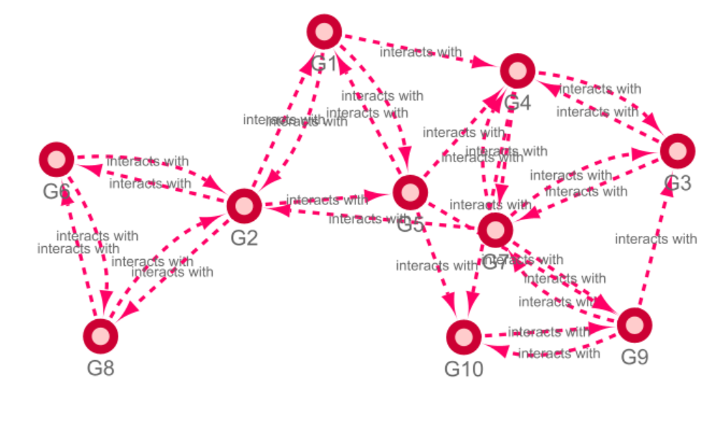
GENIE

Slide 28
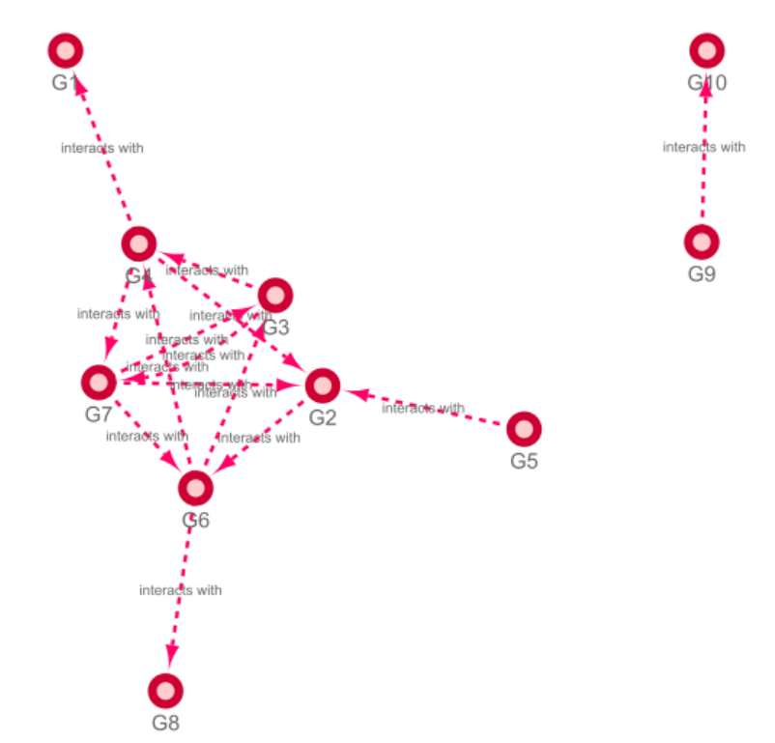
TIGRESS

Slide 29
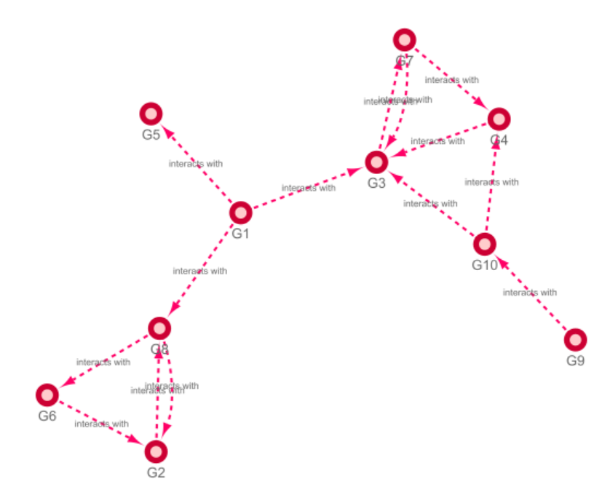
GRADIS

Slide 30
CSP Formulation
Paper F. Fioretto(2013)

Slide 31
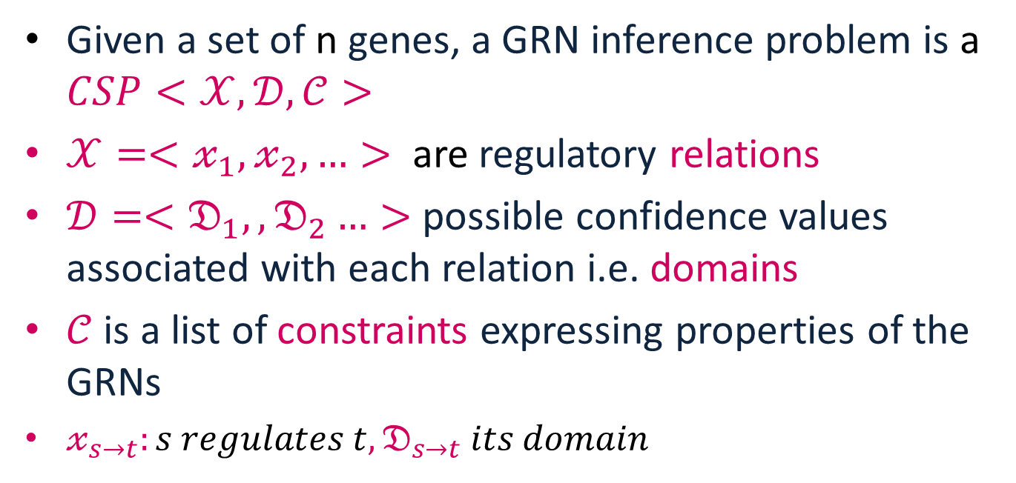
CSP Modelling
Given a set of n genes, a GRN inference problem is a $CSP<𝒳, 𝒟, 𝒞>$
$𝒳=<𝓍_{1},𝓍_{2}, …>$ are regulatory relations
$𝒟=<𝔇_{1},,𝔇_{2}…>$ possible confidence values associated with each relation i.e. domains
$𝒞$ is a list of constraints expressing properties of the GRNs
$𝓍_{s→t}:s regulates t, 𝔇_{s→t} its domain$

Slide 32
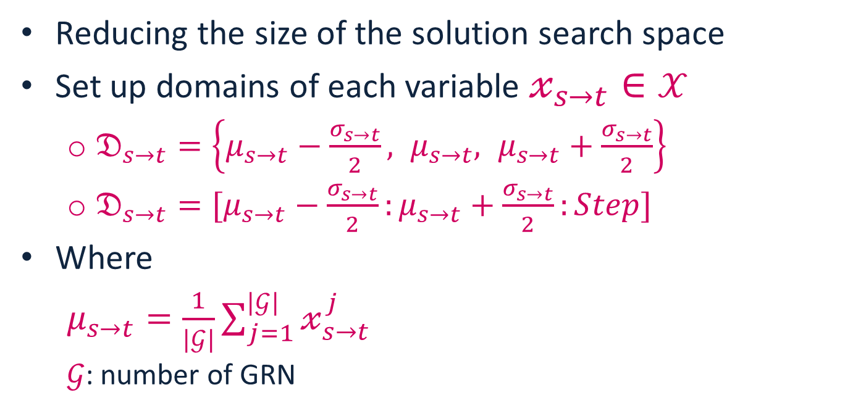
CSP domains
Reducing the size of the solution search space
Set up domains of each variable $𝓍_{s→t}∈𝒳$
$𝔇_{s→t}=\left\{μ_{s→t}−\frac{σ_{s→t}}{2}, μ_{s→t}, μ_{s→t}+\frac{σ_{s→t}}{2}\right\}$
$𝔇_{s→t}=[μ_{s→t}−\frac{σ_{s→t}}{2}:μ_{s→t}+\frac{σ_{s→t}}{2}:Step]$
Where
$μ_{s→t}=\frac{1}{|𝒢|}\sum_{j=1}^{|𝒢|}{𝓍_{s→t}^{j}}$
$𝒢$: number of GRN

Slide 33
CSP Constraints
Paper F. Fioretto(2013)

Slide 34
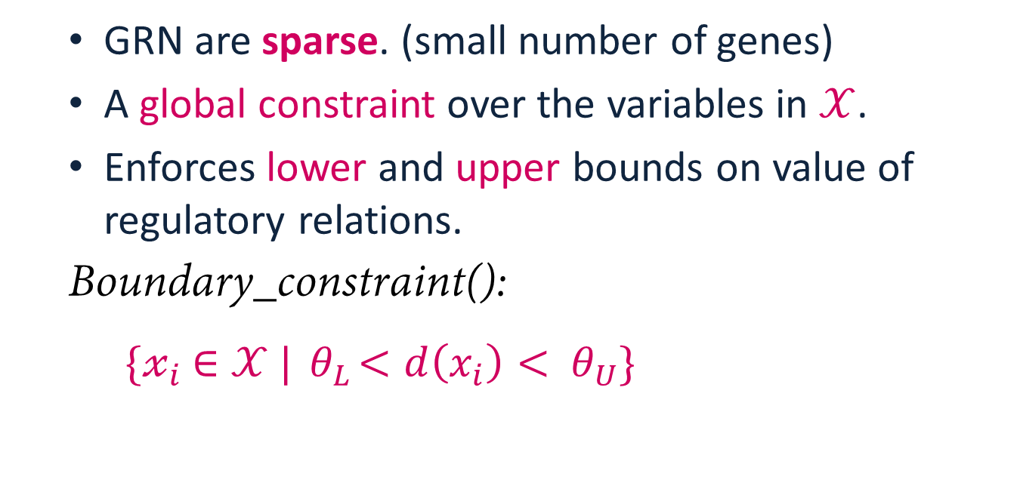
Sparseness
GRN are sparse. (small number of genes)
A global constraint over the variables in $𝒳$.
Enforces lower and upper bounds on value of regulatory relations.
Boundary_constraint():
$\{𝓍_{i}$ $∈𝒳 |{ θ}_{L}<d\left(x_{i}\right)<$ ${ θ}_{U}\}$

Slide 35

Redundant Edge
For edges with 2 directions: $𝓍_{s→t}$ and $𝓍_{t→s}$
Decides on redundant edge and discards it.
$$𝓍_{s→t}>μ_{s→t} \&\& max\left(𝔇_{t→s}\right)<\frac{𝓍_{s→t}}{2}$$

Slide 36
Overall System
Tigress
Network1
Apply constraints and get solution
Dream_4 In-Silico10
Gradis
Network2
Geinie
Network3

Slide 37
Apply constraints and get solution
Domain Calculation
Boundary Constraint
Redundant Edge Constraint

Slide 38
Implementation

Slide 39
CSP Solution
Variables
Constraints
python-constraint
Get solution from search space

Slide 40

Networks
The input to our code is the GRNs resulted from
GRADIS
TIGRESS
GEINIE

Slide 41
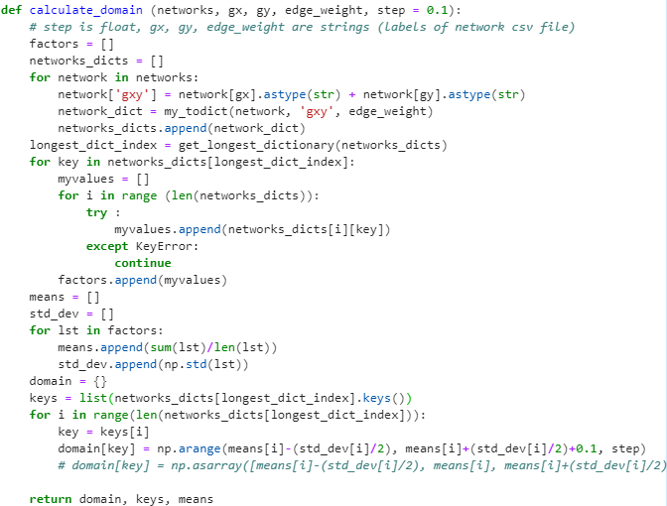
Domain Calculation

Slide 42
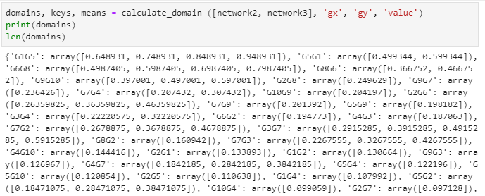
Domain Result

Slide 43
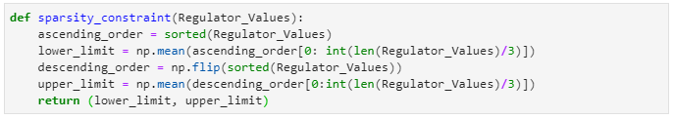
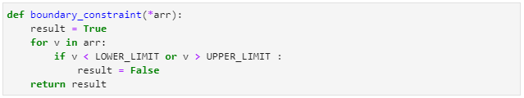
Boundary Constraint

Slide 44
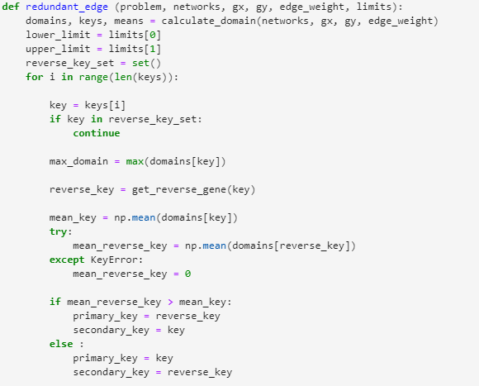
Redundant Edge Constraint

Slide 45
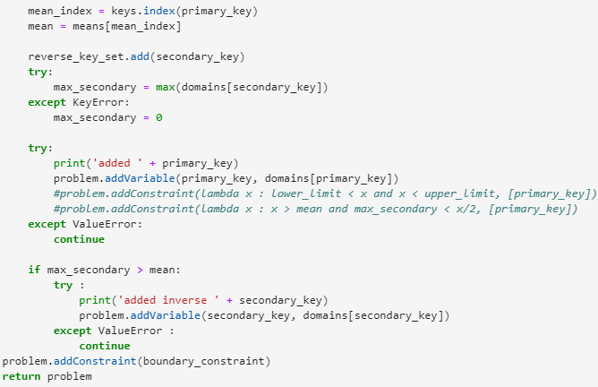
Redundant Edge Constraint

Slide 46
RESULTS

Slide 47
GENIE

Slide 48
TIGRESS
AUROC = 0.537

Slide 49
GRADIS
AUROC = 0.5
Notes:
\.

Slide 50
Thank you

